Slide 1
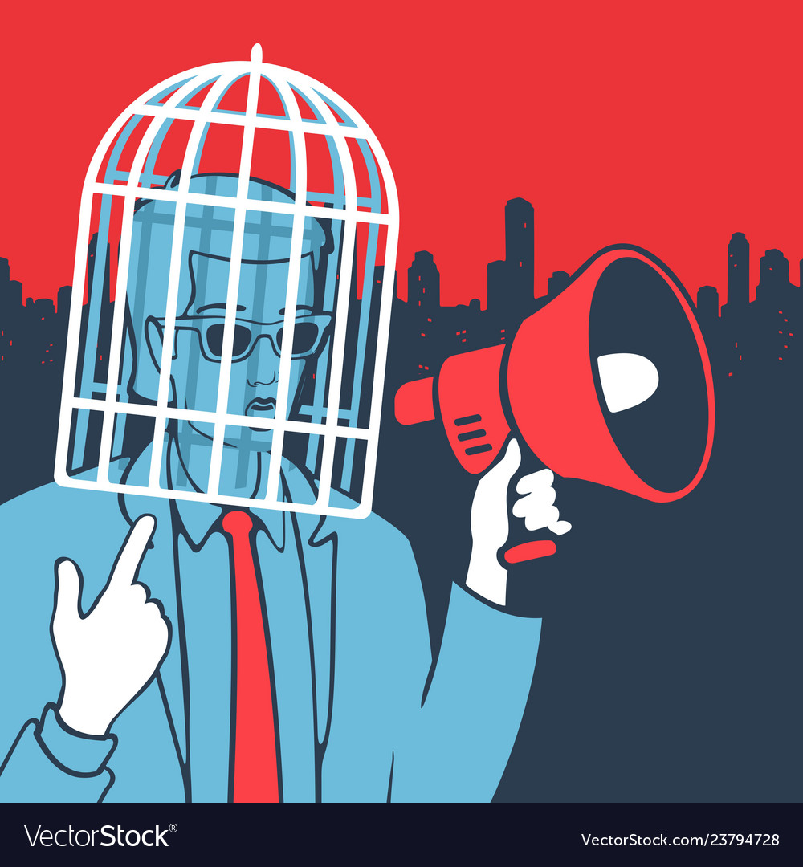
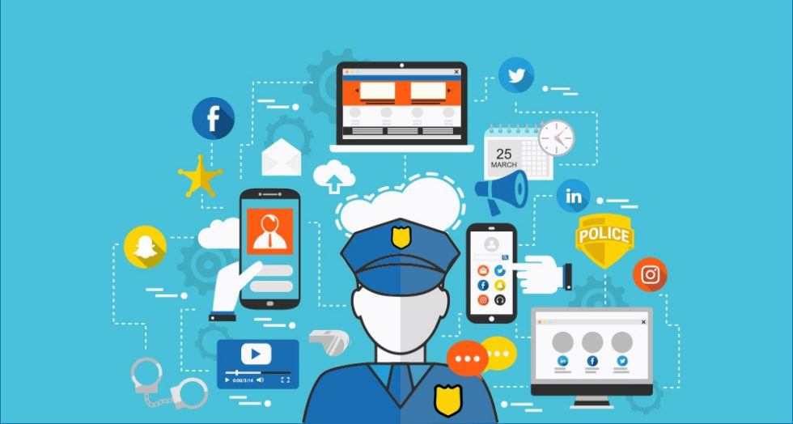

Poster Presentation on laws and regulations of Social Media In Bangladesh
Group Members
Iftakhar Ahmed Mahin (2019-1-60-206)
Nahian Niger Siddiqua (2019-2-60-074)
Introduction
Digital Act of Bangladesh
Social Media is a collective term for website and applications that focus on communication, community based input, interaction, content sharing and collaboration. People often use social media to stay in touch and interact with their family, friends, close one’s and various communities.
The provisions of the Digital Security Act were passed by the parliament in October 2018.
Section 21, If any person by means of the digital medium makes or instigates to make any propaganda or campaign against the liberation war of Bangladesh, the spirit of the liberation war, father of the nation, the national anthem, or national flag, then such act of the person shall be punished with imprisonment for a term not exceeding ten years or/with a fine not exceeding Taka one crore or/with both.
Section 25, If any person through any website or any other digital medium intentionally or knowingly transmits, publishes, or propagates any data-information which he knows to be offensive, false, or threatening in order to annoy, insult, humiliate or malign a person or publishes or propagates or abets to publish or propagate any information, as a whole or partly, which he knows to be propaganda or false, with an intention to affect the image or reputation of the country or to spread confusion. Such person shall be punished with imprisonment for a term not exceeding three years or/with fine not exceeding Taka three lac or/with both.
Section 28, If any person or group made publication, broadcast, etc. of information on the website or in any electronic format that hurts the religious values or sentiment, with an intention to hurt or provoke the religious values or sentiments, then such act of the person shall be punished with imprisonment for a term not exceeding five years or/with fine not exceeding Taka ten lac or/with both.
section 29 states if any Publication, transmission, etc. of defamatory information made or any person publishes or transmits any defamatory information as described in section 499 of the Penal Code, 1860 on the website or in any other electronic format. Such person shall be punished with imprisonment for a term not exceeding three years or/with fine not exceeding Taka five lac or/with both. If any person commits the offense for the second time or repeatedly, he shall be punished with imprisonment for a term not exceeding five years or/with fine not exceeding Taka ten lac or/with both
laws and regulations
Laws associated with social media litigation include the Digital Millennium Copyright Act and the Communications Decency Act. Defamation and privacy lawsuits can be filed based on social media content. Social networking sites often have greater protection under the law than their users.
The Digital Security Act (DSA) was enacted in 2018 to provide cyber security to citizens, but its wide scope and vague provisions are being exploited for more nefarious purposes.
Conclusion
As a conclusion, We have saw many cases for this social media post.
The Act provides absolute power to the government’s Digital Security Agency to initiate investigations into anyone whose activities are deemed harmful or a threat. The agency can also order the Bangladesh Telecommunication Regulatory Commission to remove and block any information or data on the internet.
The Act gives the police absolute power to arrest anyone, without a warrant, simply on suspicion that a crime may be committed using digital media.
The Digital Security Act criminalizes many forms of freedom of expression and imposes heavy fines and prison sentences for legitimate forms of dissent. Bangladesh’s new Digital Security Act is an attack on freedom of expression
Cases on Digital Act
Sawpon was arrested at his home in Barisal on May 14 under the Digital Security Act. Sawpon is accused of “hurting religious values or sentiments” (section 28), defamation (section 29), and “causing deterioration of law and order” (section 31).
Mahmood was arrested at his home in Dhaka on May 15, 2019, on charges that police had filed in July 2017 under the ICT Act over a Facebook post about violence in Bangladesh’s Chittagong Hill Tracts titled “Hill Bengali residents and law enforcers.”
Debabrata Das Debu, was an assistant teacher at the Chowmuhani High School in Noakhali's Hatia. According to the case dossier, Debabrata made some comments about Islam on Facebook on Oct 15 and 28, 2017. He was later confronted by a group of people outside the school for 'disparaging' the religion on Oct 31. He must also pay a fine of Tk 20,000.
© Iftakhar Ahmed Mahin & Nahian Niger Siddiqua

